Slide 1
Using Brain Science to Improve Memory
Chapter 6

Slide 2

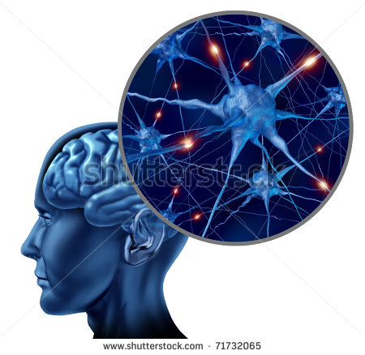
Improving Your Memory

Slide 3
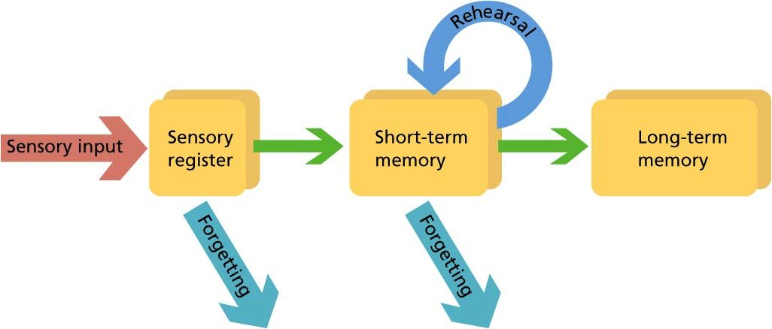
Effective Studying involves transferring learning from short-term to long-term memory

Slide 4

Short-Term Memory
Temporary space to process information
Limited capacity and duration
Quickly disappears

Slide 5
Long-term Memory
Higher capacity and duration
Requires practice or rehearsal
Use it to store important information for future use
Use it to store information for college success!

Slide 6

Forgetting
Our memories are often inaccurate and distorted.
It allows us to prioritize events.
We forget items that are not important.

Slide 7
Rate of Forgetting
Limited capacity and duration
AFTER 20 MINUTES 47%
AFTER 1 DAY 62%
AFTER 2 DAYS 69%
AFTER 15 DAYS 75%
AFTER 31 DAYS 78%
Hermann Ebbinghaus

Slide 8
When is the best time to review?

Slide 9

Within

Slide 10
Practical Memory Techniques Based on Brain Science

Slide 11

Think Positively about Learning
Stressful and unpleasant?
or
An interesting adventure?

Slide 12
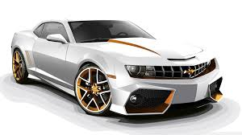
Develop an Interest
We tend to remember what interests us.
  Music
  Sports
  Hobbies
  Cars
Motivation and attitude have a big impact on memory.

Slide 13

See the big picture first.
Understand the main points first and the details second. Imagine trying to see a painting one inch at a time!

Slide 14
Meaningful Organization
Organize material into categories that are meaningful to you.
Learn from general to specific.
Make it meaningful

Slide 15

The Magical Number 7 Theory
Organize in groups of 7 or less.

Slide 16

Visualization
Make a mental picture of what you want to remember.
Commercials make good use of this technique.

Slide 17

Ready for a memory test?

Slide 18
Memory Test
I will read a list of 15 items.
See how many you can remember?
View this test as a personal challenge.
How did you remember the items?

Slide 19
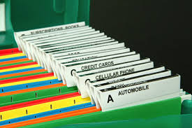
Next time use these techniques.
Meaningful Organization

Slide 20

Visualization
Make a mental picture of what you want to remember.
Commercials make good use of this technique.

Slide 21
Recitation
One of the most powerful techniques
Memories exist in the form of a chemical neural trace
Some researchers think it takes 5 seconds to establish this trace
Repeat it 5 times or keep it in your mind for 5 seconds

Slide 22
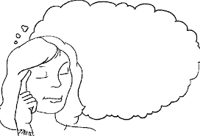
Ready for Another Test
I’ll do better this time.

Slide 23
Memory Test, Part II
1. I will read a list of 15 items.
2. Use organization, visualization or repetition to remember the items.
How many did you remember?

Slide 24

More Memory Techniques

Slide 25

Intend to Remember
Tell yourself that you are going to remember.
If you think you won’t remember, you won’t remember.
Example: Intend to remember where you put your keys!

Slide 26
Elaboration
The more you add details, connect the information or have personal meaning, the easier it is to remember.
Write it in your own words.
Use flash cards.
Make a mind map.
Underline the important points.
Discuss the information with others.
Use multi-sensory learning including audio, visual, kinesthetic and tactile strategies.

Slide 27
Elaboration Exercise

Slide 28

Distribute the Practice
Learn small amounts at a time.
Review frequently.

Slide 29
Example: SAFMEDS
Say
All
Fast
For one Minute
Each
Day
Shuffle

Slide 30
Create a Basic Background
We remember by making connections to what we already know.
At first college is difficult because you are establishing the basic background.

Slide 31

Stress and Emotions
Moderate stress can be turned into motivation.
Severe stress interferes with learning.

Slide 32

Relax while studying.
The brain works better when it is relaxed.
Use distributed practice to prepare and reduce stress.

Slide 33

You can’t remember if you are embarrassed.

Slide 34

Frustrated

Slide 35

Tired

Slide 36
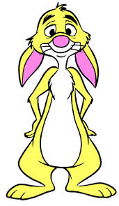

Mnemonics and Other Tricks

Slide 37
Acrostics
Creative rhymes, songs or poems.
Musical Notes: Every Good Boy Does Fine.

Slide 38
Acronyms
Shortcuts
Create new words as memory aids
Example: Use HOMES to remember the great lakes.
(Huron, Ontario, Michigan, Erie, Superior)

Slide 39
Exercise: Practice with Mnemonics

Slide 40
Peg Systems
One Bun
Two Shoe
Three Tree
Four Door
Five Hive
Six Sticks
Seven Heaven
Eight Gate
Nine Wine
Ten Hen

Slide 41
Picture the Peg
Bun

Slide 42
Connect what you want to remember. Use a picture.
Bun Milk

Slide 43
Exercise: Remember a Grocery List

Slide 44
Peg Systems
One Bun
Two Shoe
Three Tree
Four Door
Five Hive
Six Sticks
Seven Heaven
Eight Gate
Nine Wine
Ten Hen

Slide 45
Loci Systems
Use places to remember
  A House
  A Hallway

Slide 46
Other Memory Devices
Visual Clues
Say it Aloud
Have a Routine
Write It Down
Remembering Names

Slide 47

Optimize Your Brain Power

Slide 48

The health of the body and brain are connected.

Slide 49

Aerobic exercise increases oxygen to the brain.

Slide 50
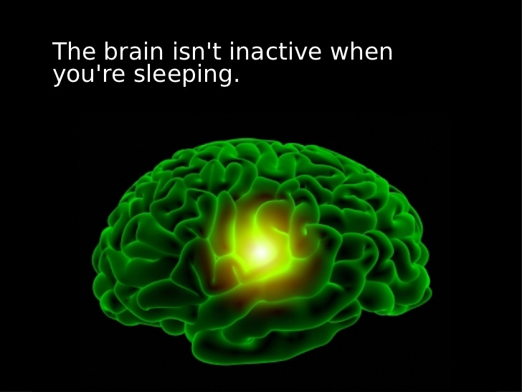
Sleep to Remember
During sleep we organize and consolidate learning.
With no sleep, it is difficulty to remember what you learned the previous day.
There is a decline of 30% in mental abilities after missing one night of sleep.

Slide 51

Lack of Sleep Causes
Difficulties with memory and learning
Increased irritability
Accidents
Illness
Lack of energy
Stress
Faster aging
Weight gain

Slide 52

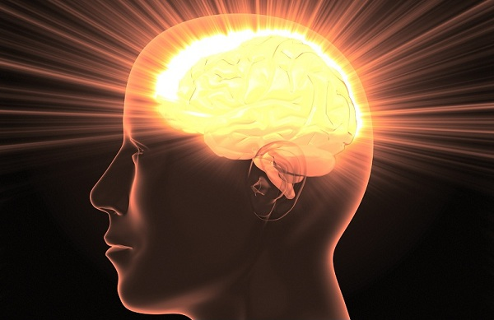
Other Ways to Maximize Brain Power
Good nutrition
Adequate water
Relaxation
Drink caffeine in moderation
Don’t smoke, abuse alcohol or use drugs
Use safety gear
Keep active

Slide 53
Stress, Relaxation and Learning

Slide 54
Is the removal of all stress helpful?

Slide 55

Stress can be motivation.

Slide 56


Two Kinds of Stress
Distress
Eustress
BY DR. HANS SELYE

Slide 57

Too much stress interferes with learning and study.

Slide 58
3 Ways to Deal with Stress
Exercise uses up the stress hormones
Use stress reducing thoughts
Using mindfulness to relax

Slide 59

Make exercise such as a brisk walk for 30 minutes, a part of your daily routine.

Slide 60
Find some activity that you like.

Slide 61
Stress Reducing Thoughts

Slide 62
Stress Reducing Thoughts
Keep cool.
It’s not the end of the world.
Relax.
I don’t have to be perfect.
Life’s like that.
Life’s too short to be miserable.

Slide 63
Exercise:
Write at least 3 stress reducing
thoughts on the 3 x 5 card.
1.
2.
3.

Slide 64
Group Activity:
Stress-Reducing Thoughts

Slide 65
Mindfulness
A relaxation technique that involves being aware of what is going on in a particular moment.
Can be used as a quick break from stress.

Slide 66

Mindfulness Techniques
Focus on your breathing.

Slide 67

Mindfulness Techniques
Notice the details in your surroundings. Take a walk.

Slide 68

Mindfulness Techniques

Slide 69

Mindfulness Techniques
Make it new. How can you do it differently?

Slide 70

Mindfulness Techniques
Mind the gap.
Instead of being impatient at a red light, use it as a break from stress.

Slide 71
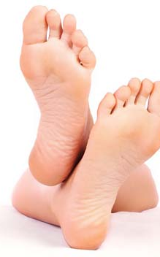
Mindfulness Techniques
Focus on the soles of your feet. Move your toes and breath until you feel calm.

Slide 72

Mindfulness Techniques
Focus on your senses. Carefully observe your surroundings including sounds and smell. Make a mental photograph.

Slide 73

Mindfullness Techniques
Imagine yourself in a pleasant place.

Slide 74

Mindfulness Techniques
A Mountain Stream

Slide 75

The ocean or beach

Slide 76

A Waterfall

Slide 77

A Tropical Scene

Slide 78

A Desert Scene

Slide 79

Make it a Habit
Exercise
Stress reducing thoughts
Mindfulness

Slide 80
Stress Management Checklist
Manage your time and organize your things
Don’t spread yourself too thin
Learn to say “no”
Cultivate friends
Participate in an extracurricular activity
Do something fun every day

Slide 81
Stress Management Checklist
Exercise regularly
Eat sensibly
Get enough sleep
Learn to relax

Slide 82
Take Action to Reduce Stress
Concentrate your efforts on doing something about the problem.
Seek information on how to solve your problem.
Make a plan of action.
Make it a priority to solve the problem.
Do what needs to be done, one step at a time.

Slide 83
Write 3 intention statements about relaxation:
I Intend to . . . .
1.
2.
3.

Slide 84

Keys to Success: Positive Thinking
You can improve your memory and your life by using positive thinking.
If you think you are beaten, you are.
If you think you dare not, you don’t.
If you like to win but think you can’t,
It’s almost certain that you won’t.
Life’s battles don’t always go
To the stronger woman or man,
But sooner or later, those who win
Are those who think they can.
-C.W. Longenecker

